Slide 1
Verbs for Learning Outcomes,
Dr. Norma Ryan
RCSI, 30 November 2017

Slide 2
Bloom’s Taxonomy of Educational Objectives
Bloom’s taxonomy (1956) is a very useful aid to writing learning outcomes.
The taxonomy consists of a hierarchy of increasingly complex processes which we want our students to acquire.
Provides the structure for writing learning outcomes
Bloom’s Taxonomy is frequently used by teachers in writing learning outcomes as it provides a ready made structure and list of verbs.

Slide 3
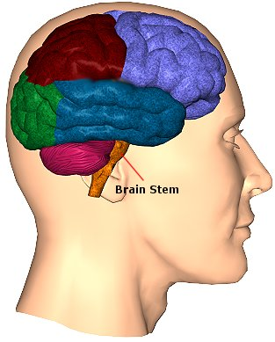
Bloom (1956) proposed that knowing is composed of six successive levels arranged in a hierarchy.
6. Evaluation
5. Synthesis
4.Analysis
3. Application
2. Comprehension
1. Knowledge

Slide 4
This area is commonly called the cognitive (“knowing” or “thinking”) domain (involving thought processes).
Bloom suggested certain verbs that characterise the ability to demonstrate these processes.
These verbs are the key
to writing learning outcomes.
The list of verbs has been
extended since his
original publication.
The “toolkit” for writing learning outcomes!

Slide 5
1. Knowledge - ability to recall or remember facts without necessarily understanding them
Use action verbs like:
Arrange, collect, define, describe, duplicate, enumerate, examine, find, identify, label, list, memorise, name, order, outline, present, quote, recall, recognise, recollect, record, recount, relate, repeat, reproduce, show, state, tabulate, tell.
6. Evaluation
5. Synthesis
4.Analysis
3. Application
2. Comprehension
1. Knowledge

Slide 6
Examples: Knowledge
Recall genetics terminology: homozygous, heterozygous, phenotype, genotype, homologous chromosome pair, etc.
Identify and consider ethical implications of scientific investigations.
Describe how and why laws change and the consequences of such changes on society.
List the criteria to be taken into account when caring for a patient with tuberculosis.
Define what behaviours constitute unprofessional practice in the solicitor – client relationship.
Outline the history of the Celtic peoples from the earliest evidence to the insular migrations.
Describe the processes used in engineering when preparing a design brief for a client.

Slide 7
2. Comprehension - ability to understand and interpret learned information
Use action verbs like:
Associate, change, clarify, classify, construct, contrast, convert, decode, defend, describe, differentiate, discriminate, discuss, distinguish, estimate, explain, express, extend, generalise, identify, illustrate, indicate, infer, interpret, locate, predict, recognise, report, restate, review, select, solve, translate.
6. Evaluation
5. Synthesis
4.Analysis
3. Application
2. Comprehension
1. Knowledge

Slide 8
Examples: Comprehension
Differentiate between civil and criminal law
Identify participants and goals in the development of electronic commerce.
Discuss critically German literary texts and films in English.
Predict the genotype of cells that undergo meiosis and mitosis.
Translate short passages of contemporary Italian.
Convert number systems from hexadecimal to binary and vice versa.
Explain the social, economic and political effects of World War I on the post-war world.
Classify reactions as exothermic and endothermic.
Recognise the forces discouraging the growth of the educational system in Ireland in the 19th century.

Slide 9
3. Application: ability to use learned material in new situations, e.g. put ideas and concepts to work in solving problems
Use action verbs like:
Apply, assess, calculate, change, choose, complete, compute, construct, demonstrate, develop, discover, dramatise, employ, examine, experiment, find, illustrate, interpret, manipulate, modify, operate, organise, practice, predict, prepare, produce, relate, schedule, select, show, sketch, solve, transfer, use.
6. Evaluation
5. Synthesis
4.Analysis
3. Application
2. Comprehension
1. Knowledge

Slide 10
Examples: Application
Construct a timeline of significant events in the history of Australia in the 19th century.
Apply knowledge of infection control in the maintenance of patient care facilities.
Select and employ sophisticated techniques for analysing the efficiencies of energy usage in complex industrial processes.
Show proficiency in the use of vocabulary and grammar, as well as the sounds of the language in different styles…..
Relate energy changes to bond breaking and formation.
Modify guidelines in a case study of a small manufacturing firm to enable tighter quality control of production.
Show how changes in the criminal law affected levels of incarceration in Scotland in the 19th century.

Slide 11
4. Analysis: ability to break down information into its components, e.g. look for inter-relationships and ideas (understanding of organisational structure)
Use action verbs like:
Analyse, appraise, arrange, break down, calculate, categorise, classify, compare, connect, contrast, criticise, debate, deduce, determine, differentiate, discriminate, distinguish, divide, examine, experiment, identify, illustrate, infer, inspect, investigate, order, outline, point out, question, relate, separate, sub-divide, test.
6. Evaluation
5. Synthesis
4.Analysis
3. Application
2. Comprehension
1. Knowledge

Slide 12
Examples: Analysis
Analyse why society criminalises certain behaviours.
Compare and contrast the different electronic business models.
Categorise the different areas of specialised interest within dentistry.
Debate the economic and environmental effects of energy conversion processes.
Identify and quantify sources of errors in measurements.
Calculate gradient from maps in m, km, % and ratio.
Critically analyse a broad range of texts of different genres and from different time periods.

Slide 13
5. Synthesis: ability to put parts together
Use action verbs like:
Argue, arrange, assemble, categorise, collect, combine, compile, compose, construct, create, design, develop, devise, establish, explain, formulate, generalise, generate, integrate, invent, make, manage, modify, organise, originate, plan, prepare, propose, rearrange, reconstruct, relate, reorganise, revise, rewrite, set up, summarise.
6. Evaluation
5. Synthesis
4.Analysis
3. Application
2. Comprehension
1. Knowledge

Slide 14
Examples: Synthesis
Recognise and formulate problems that are amenable to energy management solutions.
Propose solutions to complex energy management problems both verbally and in writing.
Assemble sequences of high-level evaluations in the form of a program.
Integrate concepts of genetic processes in plants and animals.
Summarise the causes and effects of the 1917 Russian revolutions.
Relate the sign of enthalpy changes to exothermic and endothermic reactions.
Organise a patient education programme.

Slide 15
6. Evaluation: Ability to judge value of material for a given purpose
Use action verbs like:
Appraise, ascertain, argue, assess, attach, choose, compare, conclude, contrast, convince, criticise, decide, defend, discriminate, explain, evaluate, interpret, judge, justify, measure, predict, rate, recommend, relate, resolve, revise, score, summarise, support, validate, value.
6. Evaluation
5. Synthesis
4.Analysis
3. Application
2. Comprehension
1. Knowledge

Slide 16
Examples: Evaluation
Assess the importance of key participants in bringing about change in Irish history
Evaluate marketing strategies for different electronic business models.
Appraise the role of sport and physical education in health promotion for young people.
Predict the effect of change in temperature on the position of equilibrium…
Summarise the main contributions of Michael Faraday to the field of electromagnetic induction.

Slide 17
Two other domains in Bloom’s
Taxonomy
AFFECTIVE DOMAIN (“Feeling”) concerned with value issues : involves attitudes.
5. Characterisation
Integration of beliefs, ideas and attitudes
4. Organisation
Comparing, relating, synthesising values
3. Valuing
Commitment to a value
2. Responding
Active participation in own learning
1. Receiving
Willingness to receive information

Slide 18
Active verbs for affective domain
Appreciate, accept, assist, attempt, challenge, combine, complete, defend, demonstrate (a belief in), discuss, dispute, embrace, follow, hold, integrate, order, organise, join, share, judge, praise, question, relate, share, support, synthesise, value.

Slide 19
Examples of Learning Outcomes in Affective Domain
Accept the need for professional ethical standards.
Appreciate the need for confidentiality in the professional client relationship.
Display a willingness to communicate well with patients.
Relate to participants in an ethical and humane manner.
Resolve conflicting issues between personal beliefs and ethical considerations.
Embrace a responsibility for the welfare of children taken into care.
Participate in class discussions with colleagues and with teachers.

Slide 20
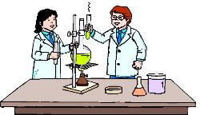
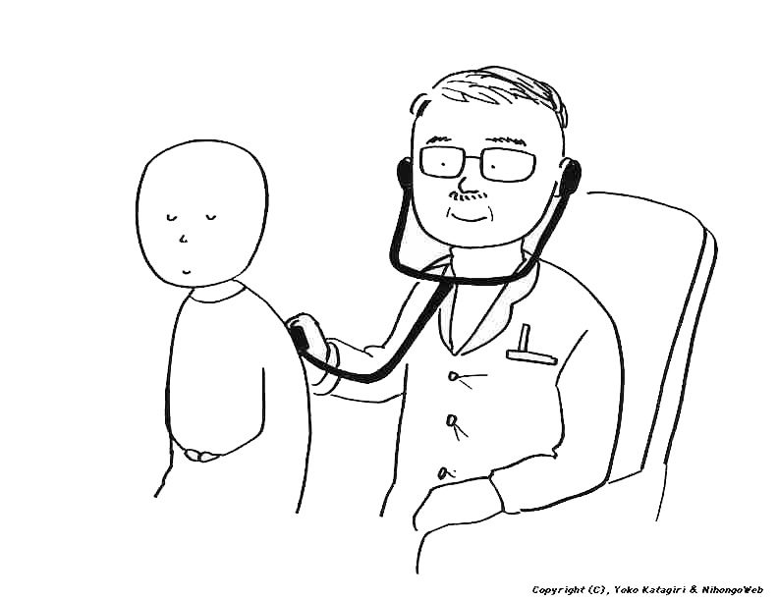
PSYCHOMOTOR (“Doing”) DOMAIN:
Work never completed by Bloom.
Involves co-ordination of brain and muscular activity. Active verbs for this domain: bend, grasp, handle, operate, perform, reach, relax, shorten, stretch, differentiate (by touch), perform (skilfully).

