Slide 1
RCSI Royal College of Surgeons in Ireland Coláiste Ríoga na Máinleá in Éirinn
Change Management Overview
RCSI Staff Training
V1

Slide 2
Contents
Reasons for Resistance to Change
Levels of Uptake
Success Factors for Implementing Change
Role of a Champion

Slide 3
Reasons for Resistance to Change
Staff may:
Not be aware of the reasons why change is necessary
Feel that there are other more important issues
Not agree with the proposed change, or feel that there is a better way to achieve the outcome
Feel there is a criticism about them
Feel that there will be extra work for them

Slide 4
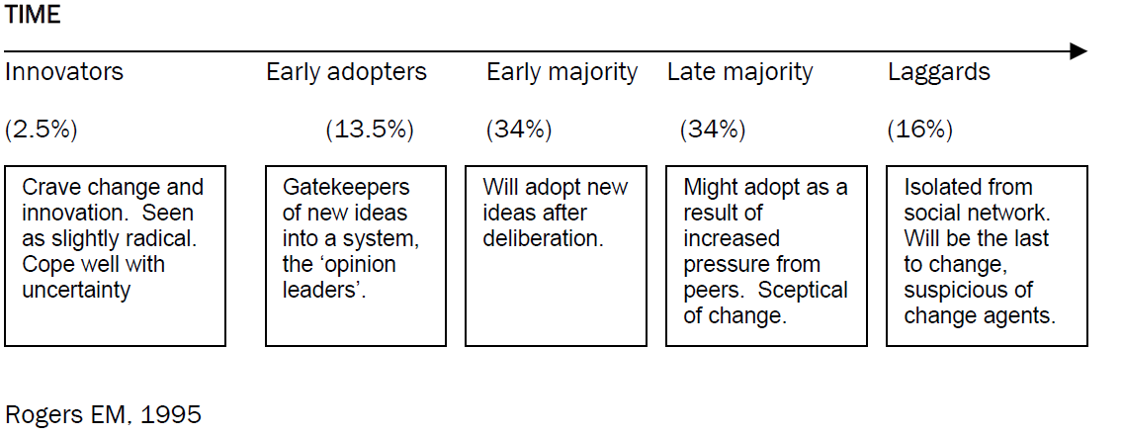
Levels of Uptake
Understand that not all people accept change at the same rate.

Slide 5
Success Factors for Implementing Change
Management Support
Have a shared vision about what the change will achieve
Support staff with training
Listen and act on questions, feedback and concerns
Acknowledge Resistance – its natural
Appoint Change Champions in each Area
Regular/ multi-media communication

Slide 6
Role of a Champion
Be prepared to introduce change
Meet regularly with your Consultants
Track progress and issues raised by your Consultants
Keep your Management Team informed
Liaise with the Revalidation Project Office as required

